Slide 1


Slide 2
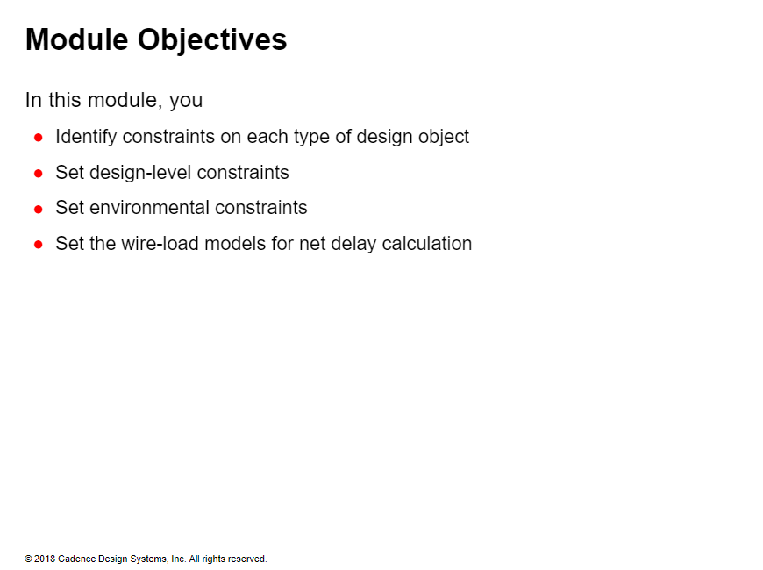

Slide 3
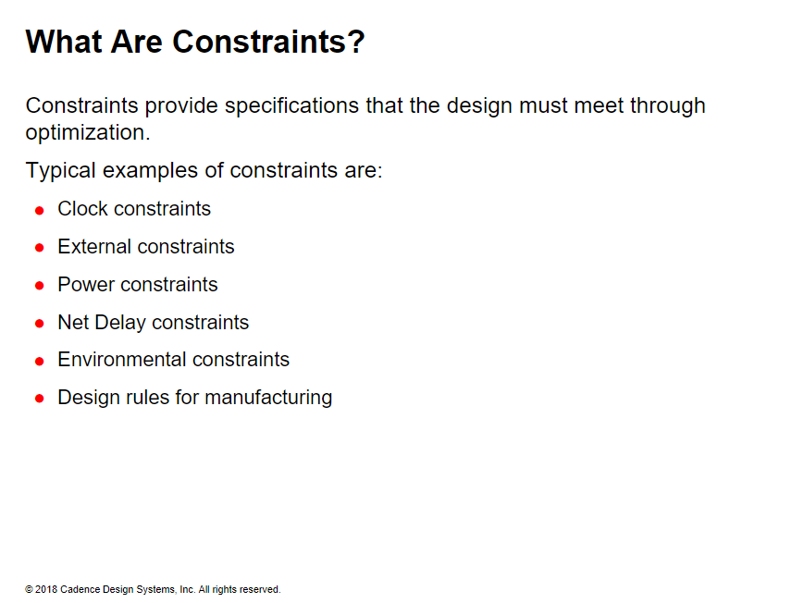

Slide 4
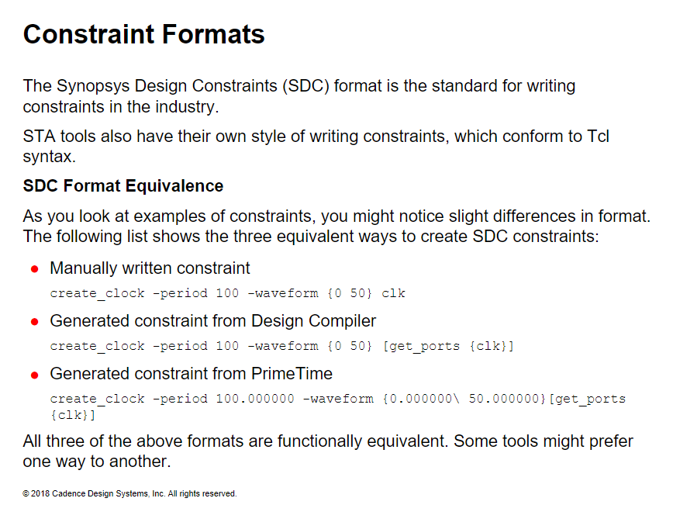

Slide 5
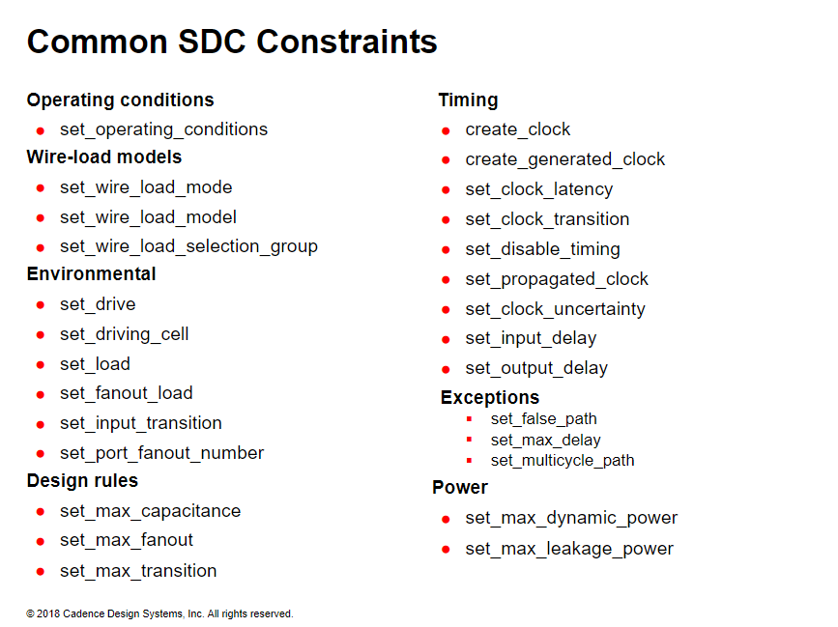

Slide 6
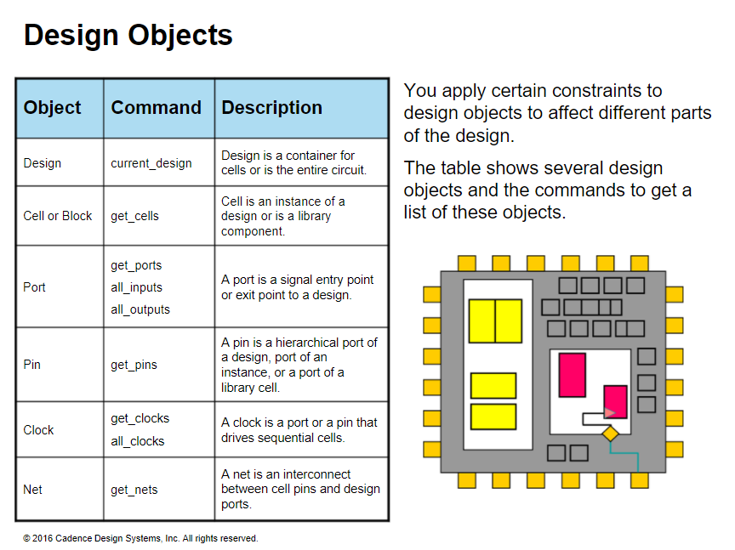

Slide 7
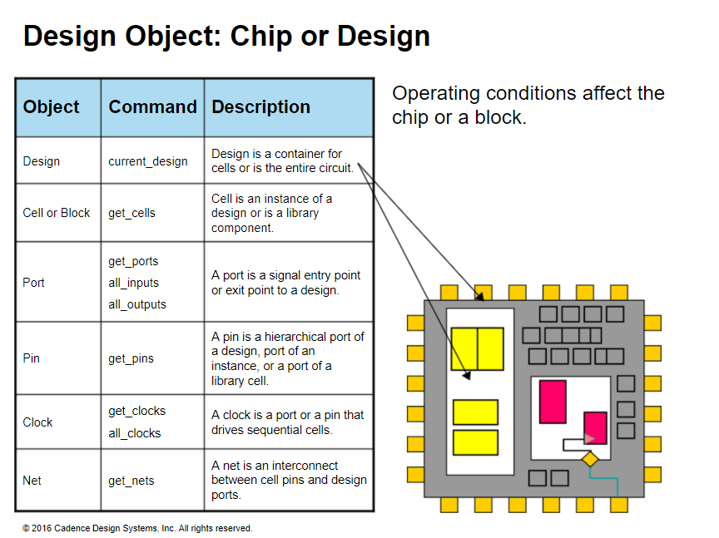
Notes:
In multisupply voltage (MSV)designs, operating conditions can ce ser on a block

Slide 8
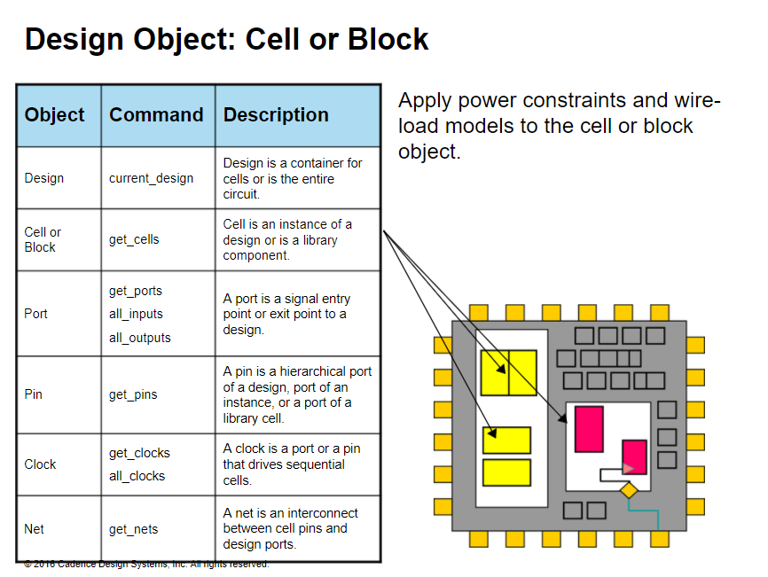

Slide 9
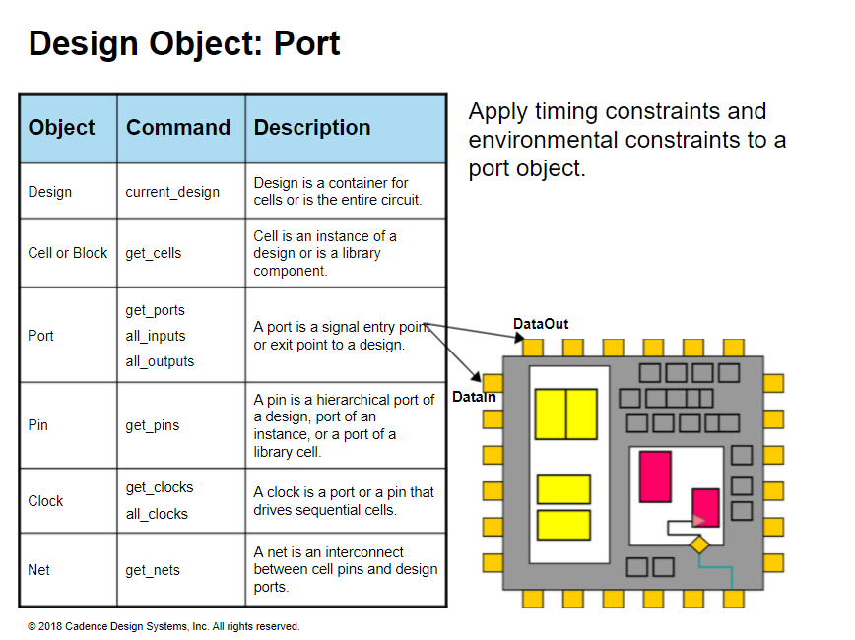

Slide 10
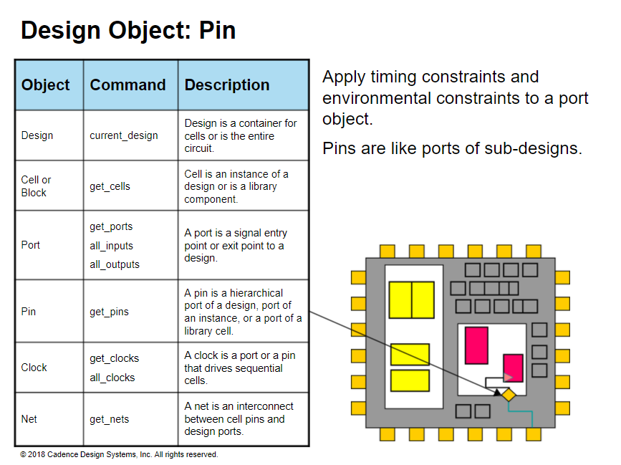

Slide 11
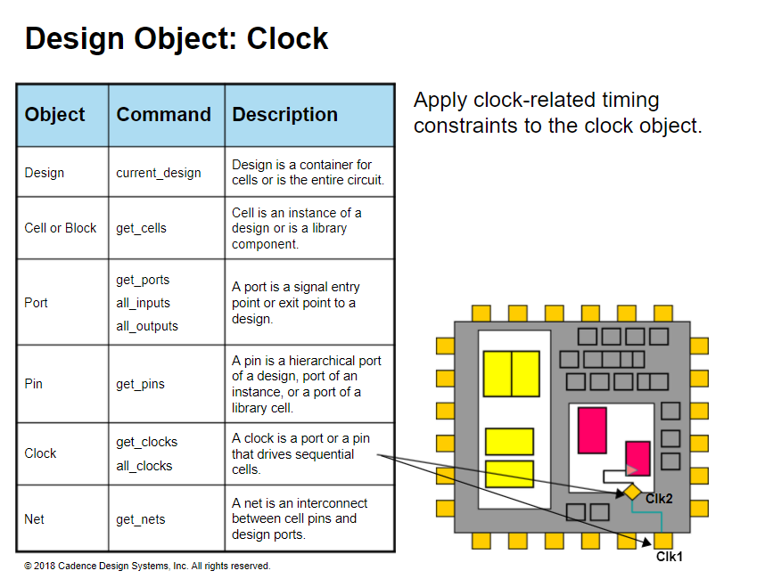

Slide 12
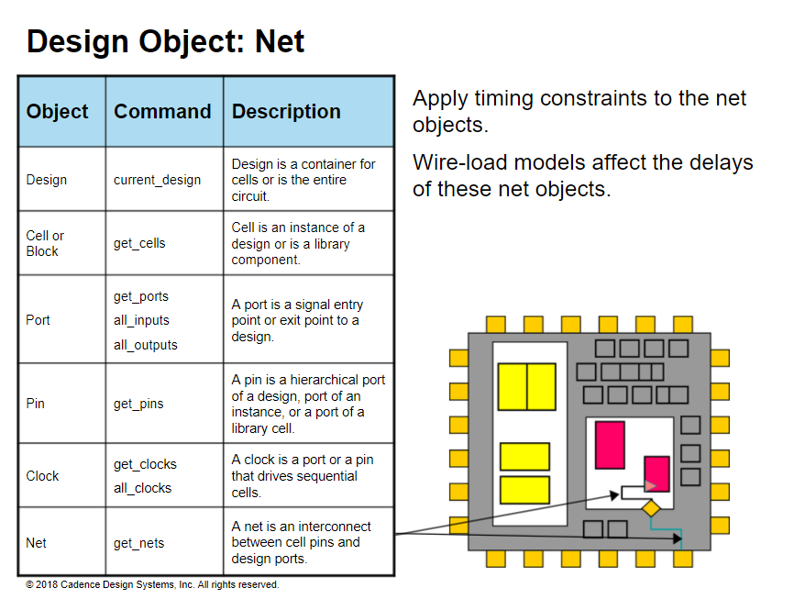

Slide 13
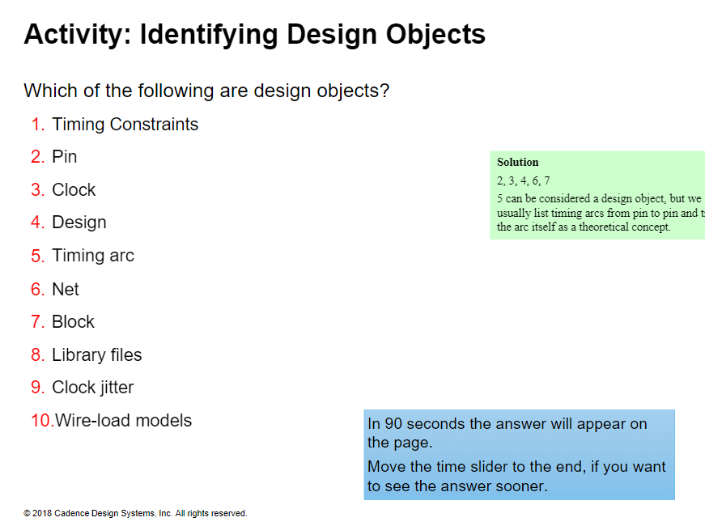

Slide 14
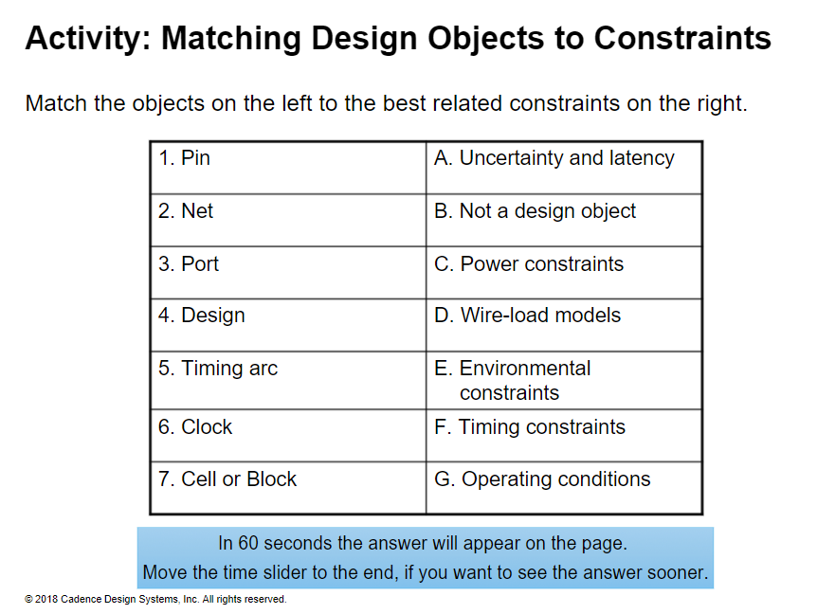

Slide 15
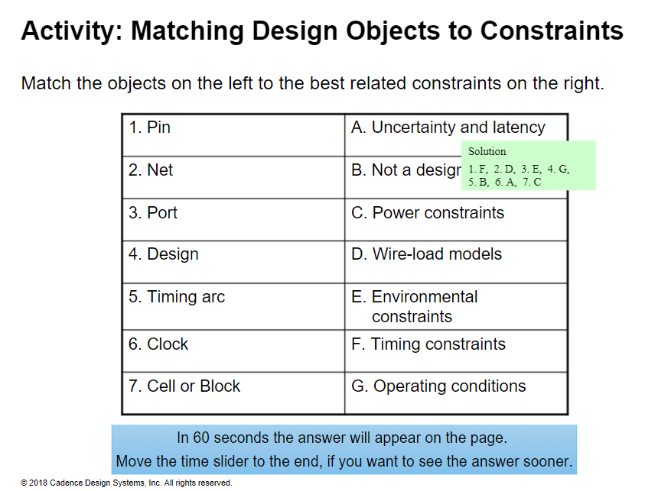

Slide 16
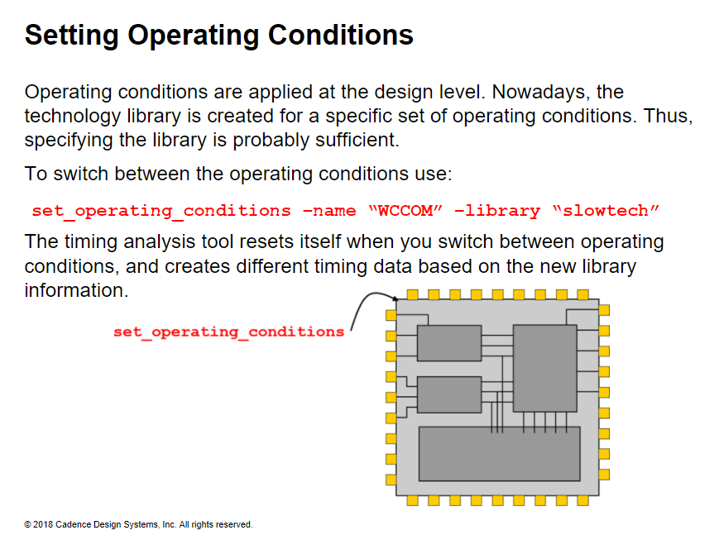
Notes:
Setting Operating Conditions
Process, temperature, and voltage define the operating conditions of a chip or design.
After a chip or design is manufactured, the operating conditions under which it will likely work is important for calibrating the chip characteristics.
Each design is tested for the set of operating conditions it will work under, and beyond which it might fail.
The operating conditions are usually specified for the entire design. You might have multisupply and multivoltage in different areas of a design.
For this course, assume that the design is tested for one operating condition at a time.

Slide 17
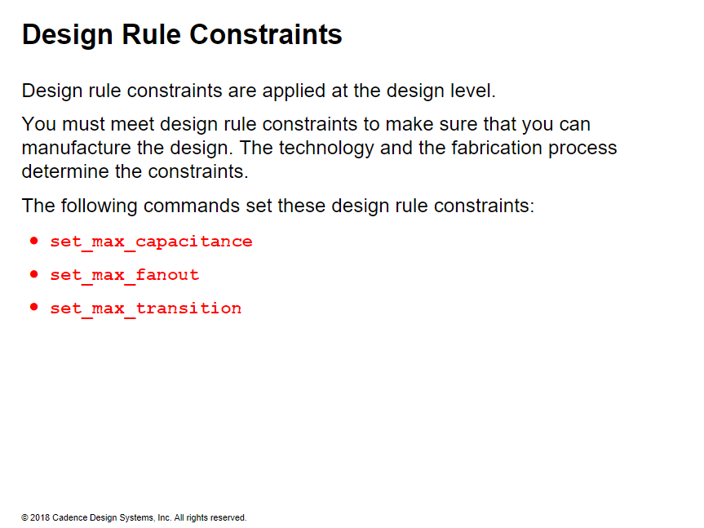

Slide 18
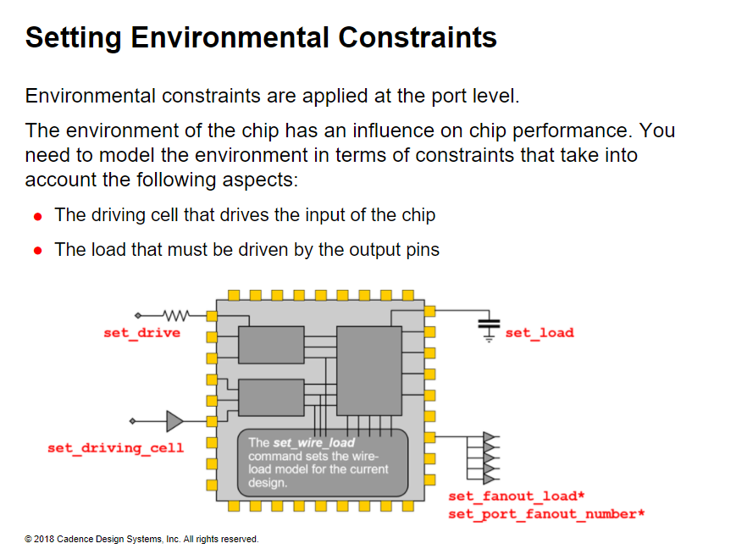
Notes:
Think of environmental constraints as attributes that are applied to ports

Slide 19
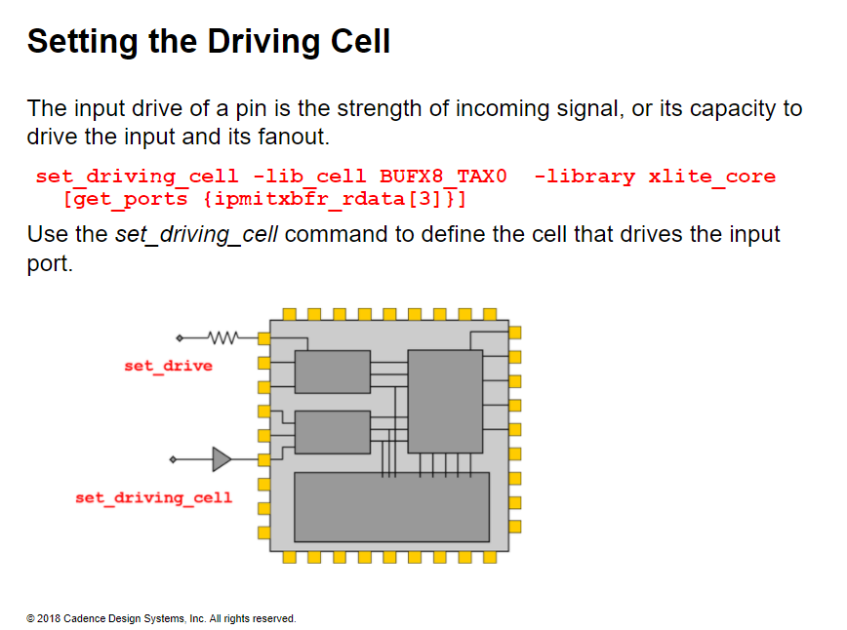
Notes:
You can also use the set_drive command to set the driving capability of the input port.
The set_driving_cell command is also used as a design rule constraints for the ports

Slide 20
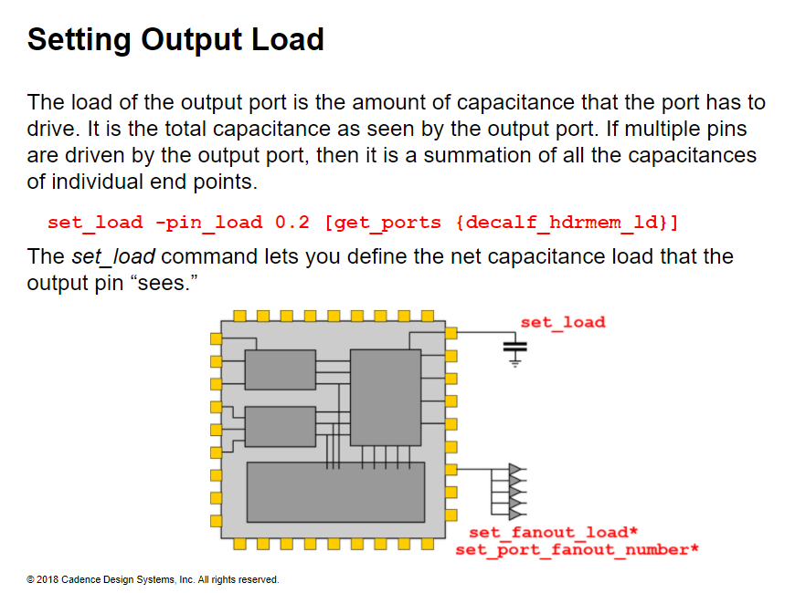
Notes:
Setting Output Load
You can specify the same information as shown above using the following commands together:
The set_port_fanout_number command lets you specify the fanout of the output port. This command is used in conjunction with the set_fanout_load command.
set_port_fanout_number 5 [all_outputs]
The set_fanout_load command lets you specify the value of the input capacitance of a cell driven by the output port.
set_fanout_load 100x100 -library slow [get_ports CELLX1/A*]
The set_port_fanout_number and set_fanout_load commands are also used as design rule constraints for the ports.

Slide 21
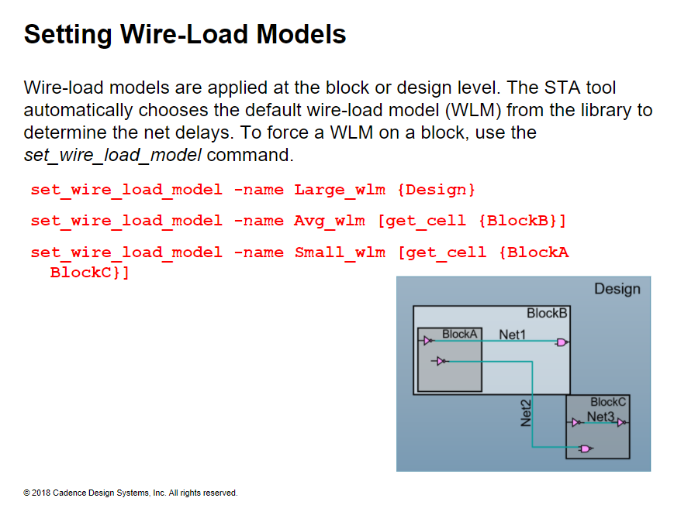
Notes:
Setting Wire-Load Models
The STA tool uses a wire-load mode specified in the library to calculate the net delays.
When you do not specify a wire-load mode, the tool automatically selects the default from the library.
Wire-load models are applied during synthesis to determine the interconnect delays.
Wire-load models are characterized based on area.
When no wire-load model is specified, the STA tool automatically selects the default from the library.
To modify the model for a block, or a set of blocks, use the set_wire_load_model command.

Slide 22
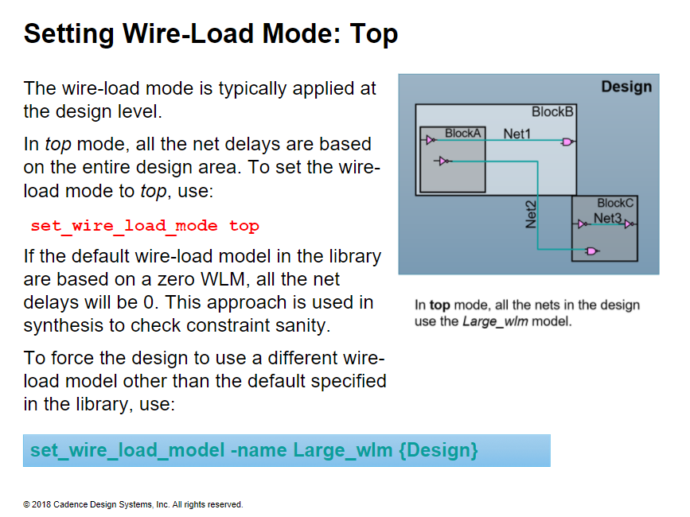
Notes:
Setting Wire-Load Mode: Top
To modify the mode, use the set_wire_load_mode command.
In top mode, the design level wire-load is applied to all nets.
This can be very pessimistic because you are implying that all nets have delays of the average largest net in the design.

Slide 23
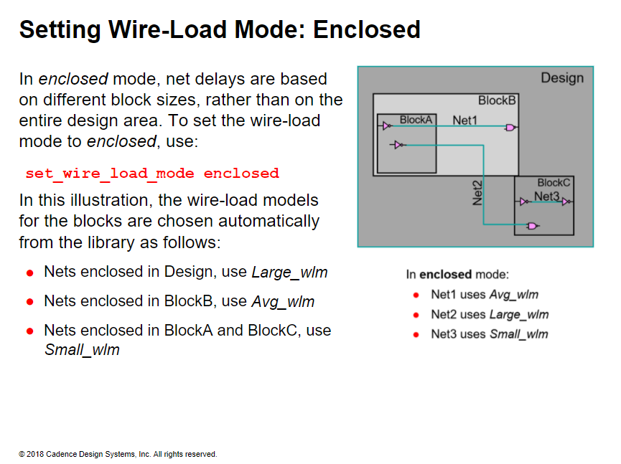
Notes:
Setting Wire-Load Mode: Enclosed
In enclosed mode, the area that encloses the entire net is the model for that net.
Example
Here are the wire-load models available from a library:
Large_wlm is based on an area of 8000 units.
Avg_wlm is based on an area of 4000 units.
Small_wlm is based on an area of 1000 units.
Here are the block areas for a design example.
BlockA and BlockC are each 950 units in area.
BlockB is 3000 units in area and the entire design area is 6000 units. In enclosed mode, the tool calculates the delay of Net1 automatically in the following way:
1. Determines which block area encloses the net. It is BlockB. If the wire-load model is set for that block area, the tool goes to Step 4.
2. Computes the block area. In this case for BlockB, it is 3000 units.
3. Chooses the next larger area-based WLM (40003000, so it is Avg_wlm).
4. Calculates the delay of Net1 from the wire-load model (Avg_wlm).

Slide 24
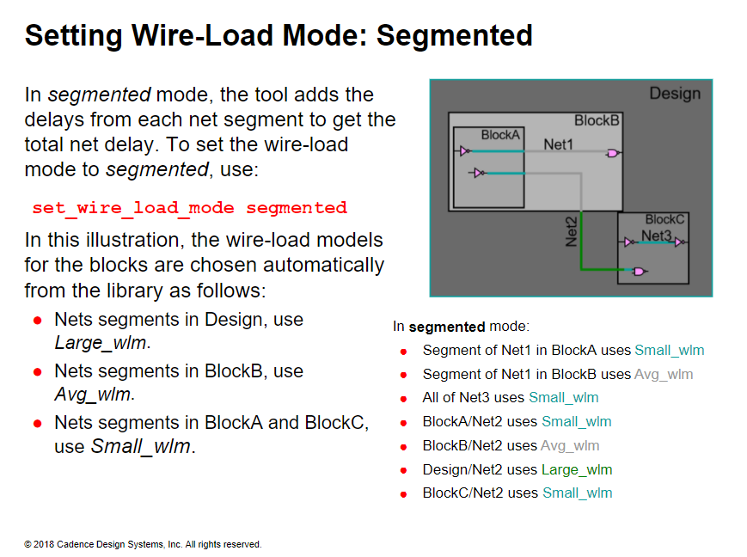
Notes:
Setting Wire-Load Mode: Segmented
In segmented mode, all the net segments in the design use the wire-load model of the block they reside in.
This might sound like the most logical choice, because each segment in that block will not have delays bigger than the size of the block. However, for the tool, this is computation intensive and it runs more slowly.
Another problem with the segmented mode is that if the nets fall under critical paths, the wire-load model of the block often switches between two wire-load models, and the results of each synthesis run can become unreliable.
Also, remember that the wire-load models are statistical values: they might not be as reliable for all types of designs.

Slide 25
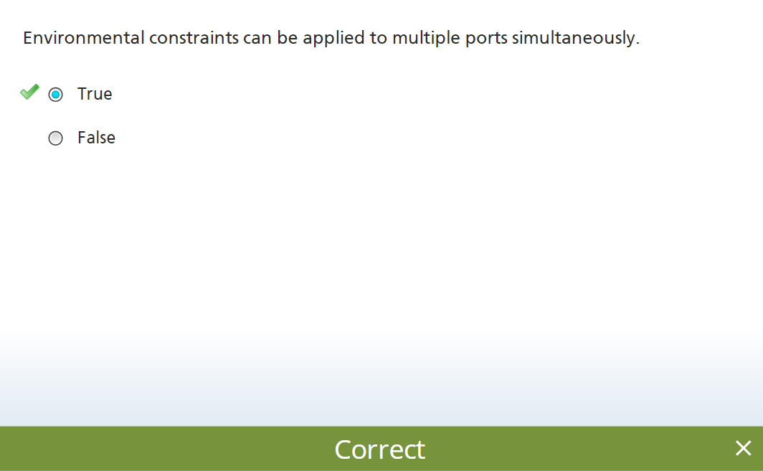

Slide 26
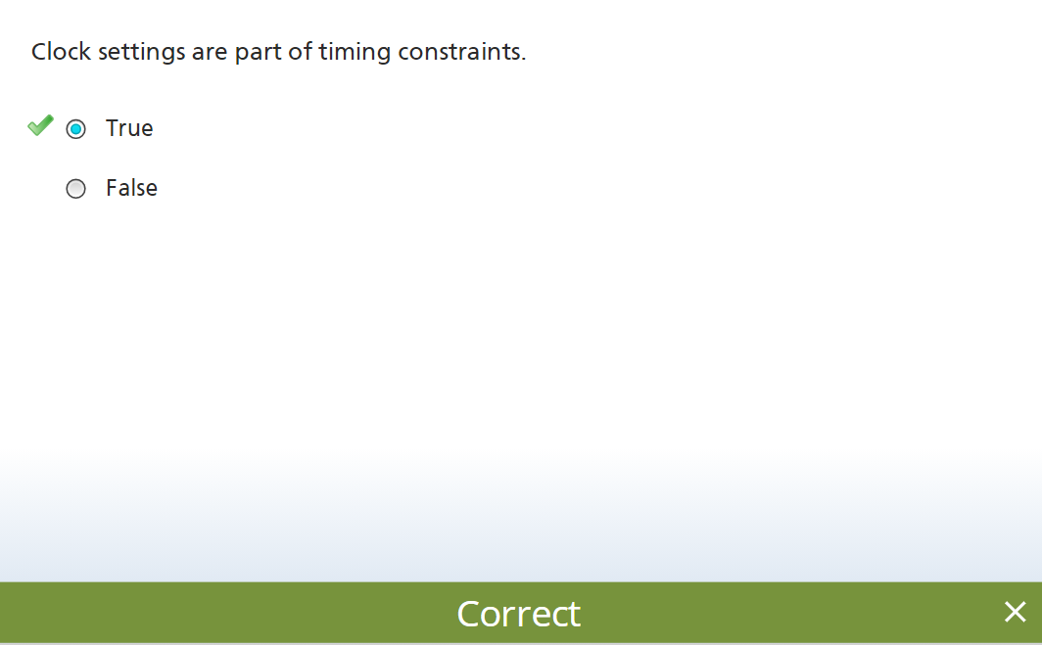

Slide 27
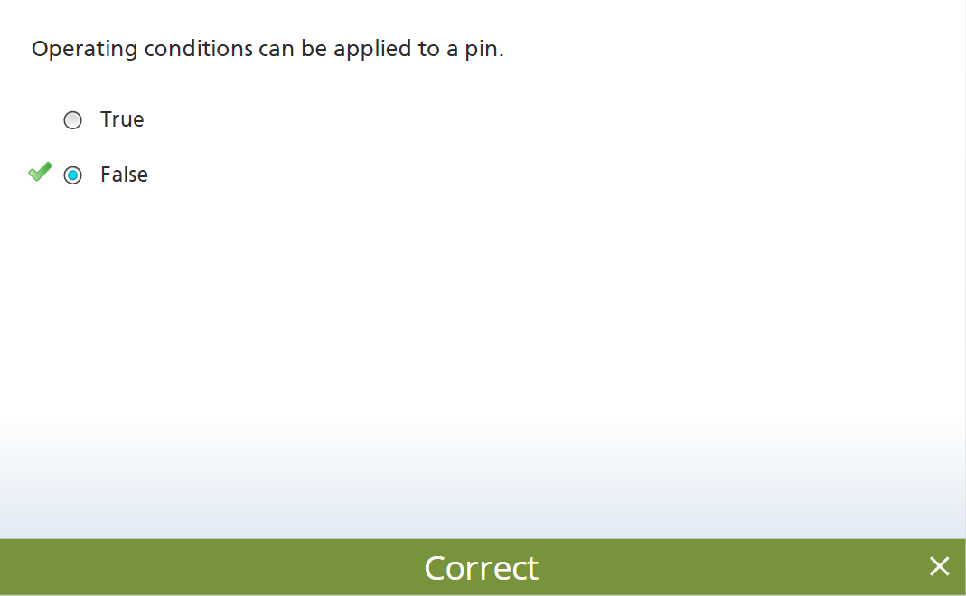

Slide 28
